Slide 1
Introduction to mixed models in ecology and evolution
Alastair Wilson (Biologist), Ottawa, Nov 2019

Slide 2
Ground rules
This is not a proper statistics course
I am not a proper statistician
I hope to tell you things that are useful
I may tell you a few things that are wrong
I am not accountable for what you do with your data….

Slide 3
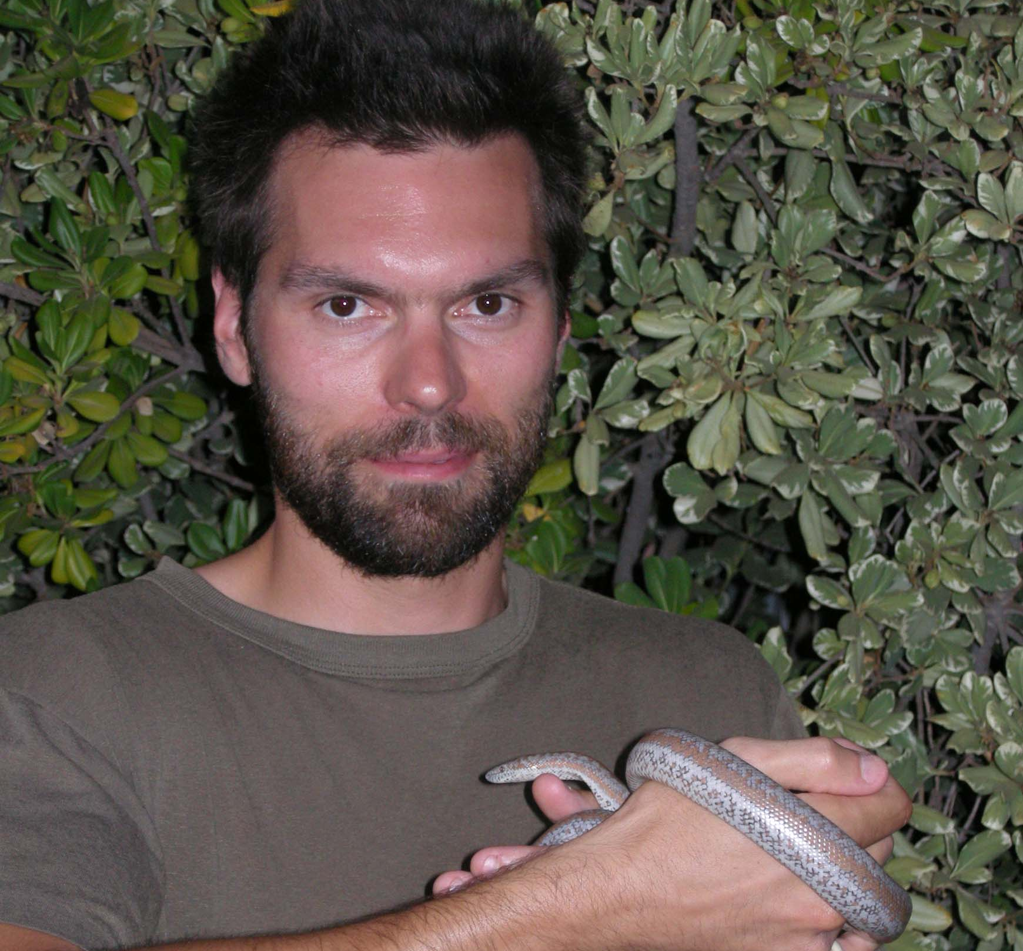

I put sheep in gimp masks
I wish I was a Bond villain
Should you trust either of these people?

Slide 4
Aims
Provide a simple, non-technical overview of linear mixed effect models
Stimulate some thinking about your own data
Provide some initial hands on experience with simple mixed models and ‘random slope’ models
Maybe…start to see why multivariate mixed models are really useful

Slide 5

This afternoon
Us talking for a bit
Univariate mixed models
Partitioning variance
FAQ – superficial tour of some practical issues
Random regression or random slope models
Interrupt if you have a question!
You trying some univariate mixed models
Using LME4 package in R
Fits mixed models in a frequentist (REML) way
We will guide you
We made a tutorial you can revisit later
We can take breaks.. I hope

Slide 6
A simple linear model
y_{i} = b x + c + ε_{i}
We typically fit this model to estimate
Rate of change in y with x
What value of y to expect when x=0 (or some other x value of interest).
y
slope = b
c
ε_{i}
x

Slide 7
A simple linear model
y_{i} = b x + c + ε_{i}
But it is also a model of variance –
Residual variance Vε (or V_{R}) is our estimate of the variance in y after accounting for effects of x.
Sometimes the goal is to estimate V_{R} not to explain it away.
Achieving a big R-squared is not always the point.
y
slope = b
c
ε_{i}
x

Slide 8
A simple linear model
y_{i} = b x + c + ε_{i}
What we hope/assume/pretend
Residual variance is homogeneous with x
y
slope = b
c
ε_{i}
x

Slide 9
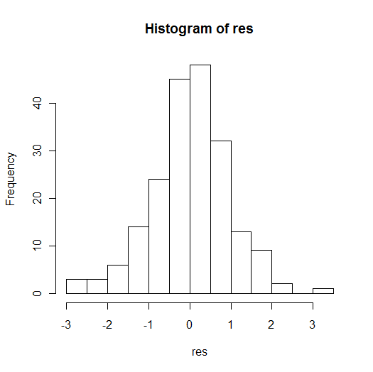
A simple linear model
y_{i} = b x + c + ε_{i}
What we hope/assume/pretend
Residual variance is homogeneous with x
Residuals are normal (unless GLM used)
y
slope = b
c
ε_{i}
x

Slide 10
A simple linear model
y_{i} = b x + c + ε_{i}
What we hope/assume/pretend
Residual variance is homogeneous with x
Residuals are normal (unless GLM used)
Residuals are independent of each other and therefore uncorrelated across observations
y
slope = b
c
ε_{i}
x

Slide 11
A simple linear model
y_{i} = b x + c + ID + ε_{i}
y
Assuming data are independent when they aren’t is pseudoreplication.
Modelling the source of non-independence (here ID) ‘fixes’ the problem.
Statistical inference on x will now be valid
c
x
We are now also asking whether individual identity ID explains variance in y.
We may or may not care about the answer to this.

Slide 12
With repeated measures, variance in a trait could be split into among- vs. within- individuals*
size
between-individual
variation between means
A
B
C
D
individual
* or years, patches, mothers, petri dishes, families, genotypes etc

Slide 13
With repeated measures, variance in a trait could be split into among- vs. within- individuals*
size
Repeatability = variance among individuals
total variance
A
B
C
D
individual

Slide 14
Why care about trait repeatability?
Standardised measure of variation among individuals.
Selection acts on trait differences among individuals
Plasticity versus personality in behaviour
Upper limit for heritability (normally)
Maternal, year, nest effects etc also important – use more random effects!

Slide 15

If we have repeated measures, how should we model individual identity ? (or other grouping variables)
Repeated measures ANOVA
Add ID as a (fixed) factor in (G)LM
Add ID as random effect in a mixed model (G)LMM

Slide 16

Advantages of mixed effect models
Handles unbalanced data sets (balance always better)
Incorporate fixed effects (i.e. partition variance conditional on known or hypothesised effects)
Robust to deviations from normality (relatively, generalised mixed models also possible)
Robust to missing data (relatively, missing data is never ideal of course)
Efficient with respect to degrees of freedom (when you fit ID as a random effect)

Slide 17
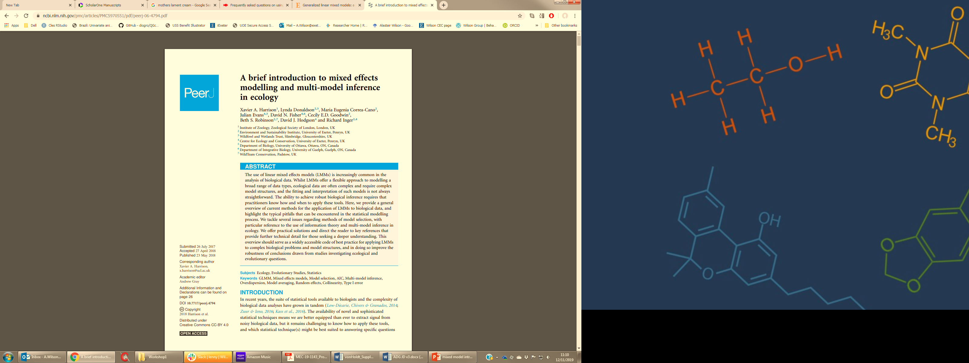


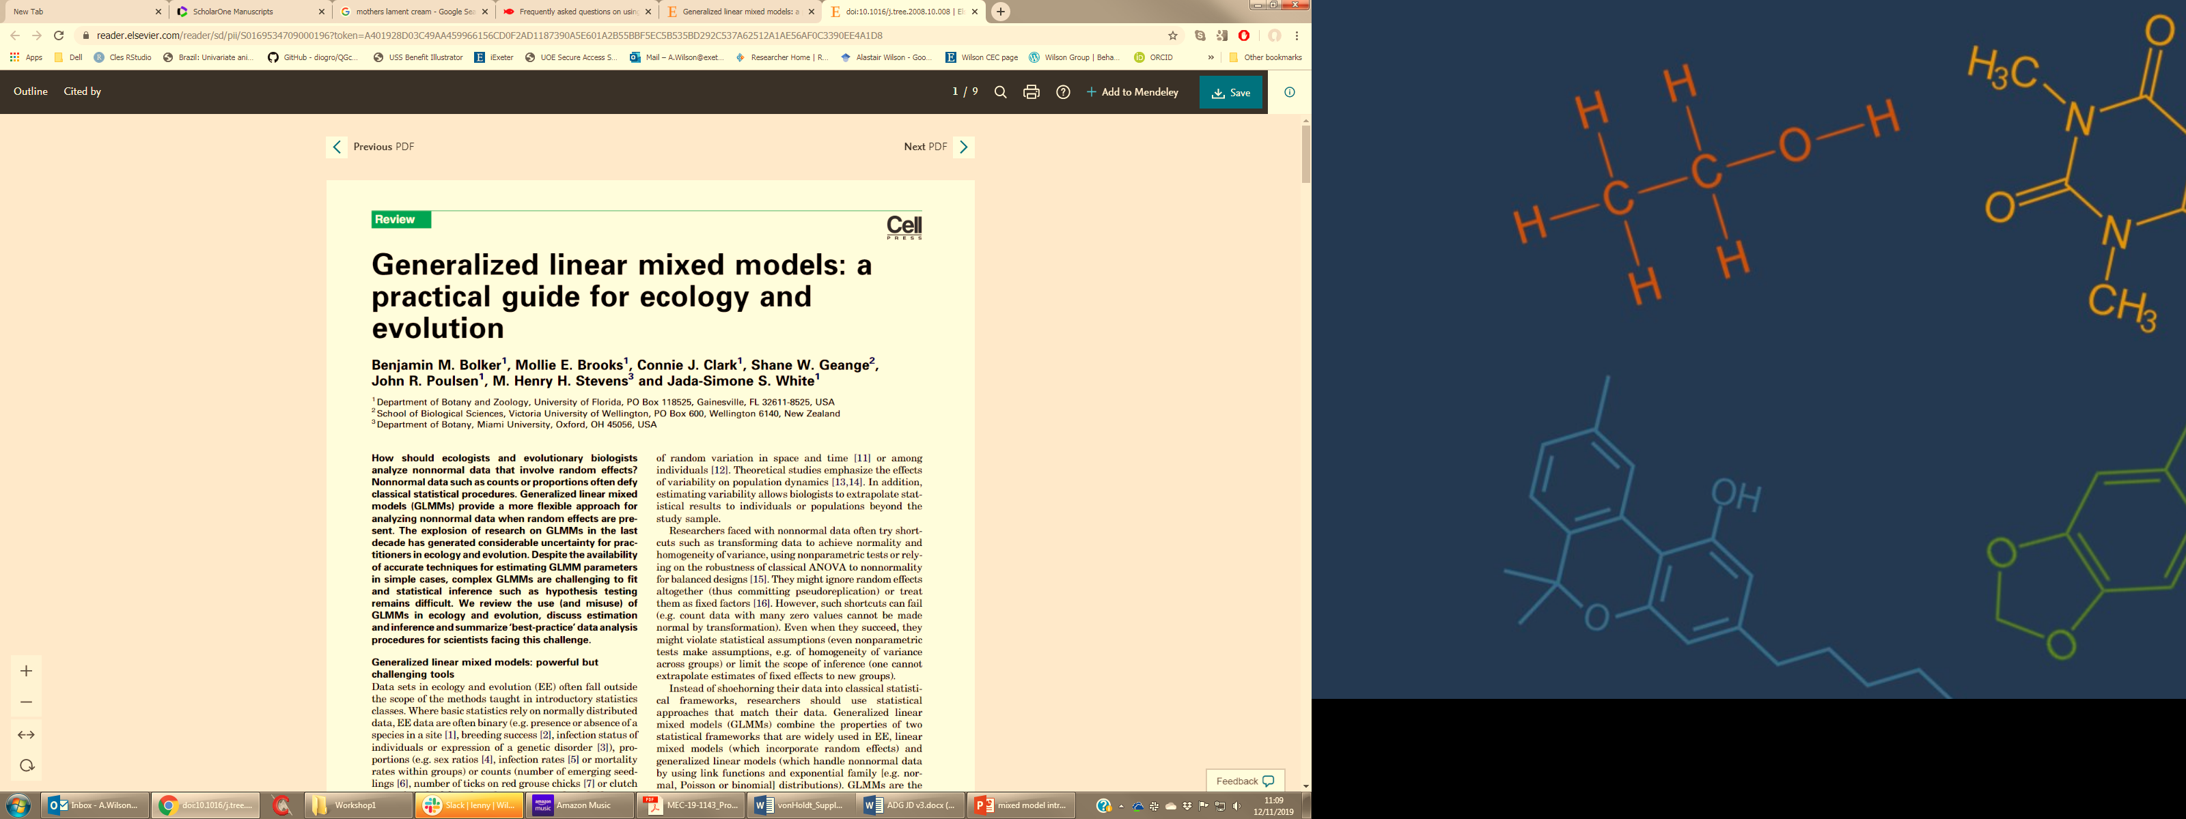
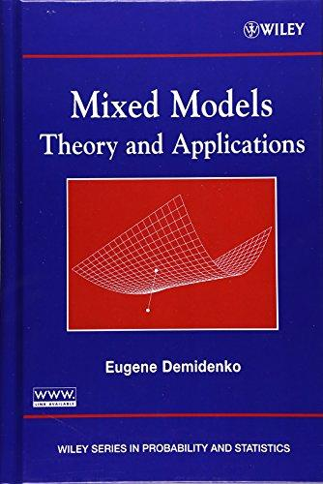
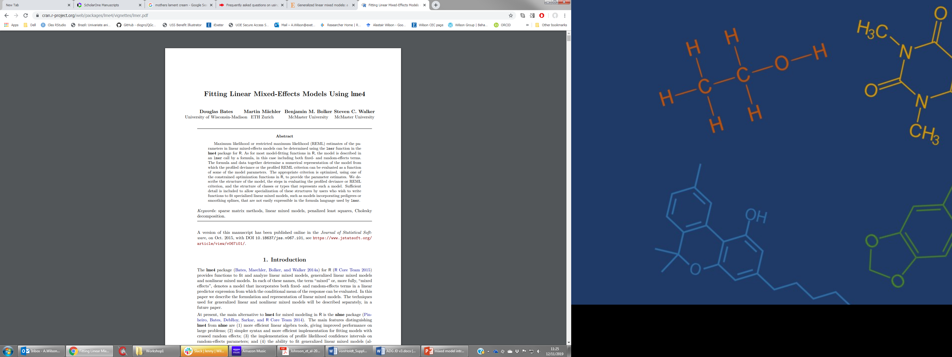

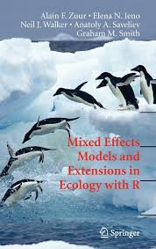

Loads of (fairly) accessible treatments that cover linear mixed models (LMM) generally
+ model selection/inference, power, specific applications (e.g. quant gen, plasticity), GLMM options etc etc

Slide 18
Mixed models contain fixed and random effects
y_{i} = b x + c + ID + ε_{i}
Fixed effects model the mean
b=0.25 (0.10), P=0.02
C =1.2 (0.05), P<0.001
y
c
x

Slide 19
Mixed models contain fixed and random effects
y_{i} = b x + c + ID + ε_{i}
Fixed effects model the mean
b=0.25 (0.10), P=0.02
C =1.2 (0.05), P<0.001
Random effects partition variance around the (fixed effect) mean
Instead of getting a single residual variance (= variance not explained by fixed effects we partition it into two components - V_{ID} and V_{RES}
y
c
x
Notes:
19

Slide 20
Mixed models contain fixed and random effects
y_{i} = b x + c + ID + ε_{i}
Standard assumptions
Residuals are normally distributed with a mean of 0 and a variance (V_{res}) to be estimated, and uncorrelated across observations.
Random effects (e.g. ID) are normally distributed with a mean of 0 and a variance (V_{ID}) to be estimated. They are uncorrelated across individuals.
Random effects and residuals are therefore deviations from the (fixed effect) mean.
y
c
x

Slide 21
Random effects partition variance (not explained by fixed effects)
y = mu + ID + ε
Vp = V_{ID} + V_{res}
Repeatability = V_{ID}/V_{P}
V_{P}
V_{res}
V_{ID}

Slide 22
Random effects partition variance (not explained by fixed effects)
2) y = mu + ID + year + ε
Vp = V_{ID} + V_{yr} + V_{res}
V_{P}
V_{res}
V_{res}
V_{yr}
V_{ID}
V_{ID}

Slide 23
Random effects partition variance (not explained by fixed effects)
3) y = mu + age + ID + year + ε
Vp = V_{ID} + V_{yr} + V_{res}
V_{P}
V_{res}
V_{res}
V_{res}
V_{yr}
V_{yr}
Age explains some of V_{res}.
Repeatability will likely go up if V_{P} calculated as the sum of variance components (as opposed to observed variance in y).
V_{ID}
V_{ID}
V_{ID}

Slide 24

1. Should an effect be Fixed or Random ?
FAQ’s

Slide 25
Fixed or Random ?
"Factors can either be fixed or random.
A factor is fixed when the levels under study are the only levels of interest.
A factor is random when the levels under study are a random sample from a larger population and the goal of the study is to make a statement regarding the larger population."
A. Statistician

Slide 26
Fixed or random?
Fitting fixed effects tells you the impact on the mean of each factor level e.g., male vs female.
Costly in DF.
Fitting a random effect tells you about the variance explained by a factor that (probably) has many levels, some of which are represented in your data
Uses 1 DF
Most sensible strategy might depend on the question.

Slide 27
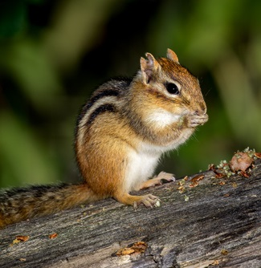
We are primarily interested in among-individual differences in litter size
We have a long term data set and suspect year to year variation is also present
ID as random plus YEAR as FIXED EFFECT
Removes variance due to between year environmental differences
Yields estimated mean for each year in the data set (using 1DF per year in data set)
Estimate R of litter size as conditional on year effects
ID as random plus YEAR as RANDOM EFFECT
– Estimate variance explained by between year differences (1DF used)
-V_{Year} contributes to calculation of V_{P} and R (typically)
-Estimate unconditional repeatability of litter size

Slide 28
2. How should I fit my mixed model? REML vs MCMC
FAQ’s
Frequentist
Bayesian

Slide 29
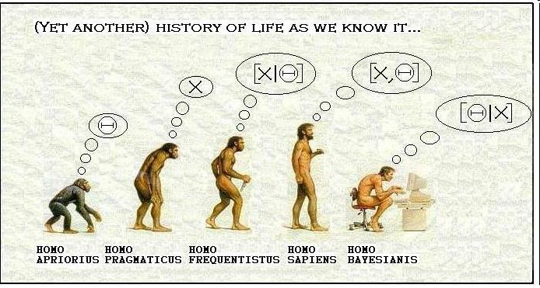
Bayesian approaches do make a lot of sense to me….

Slide 30
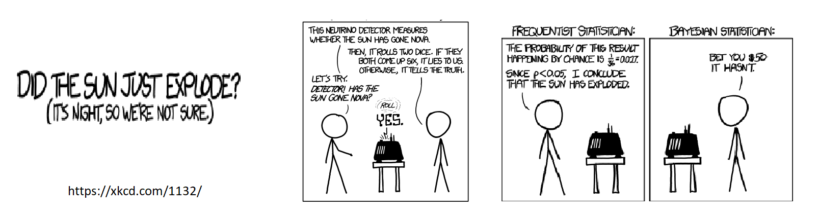

Slide 31
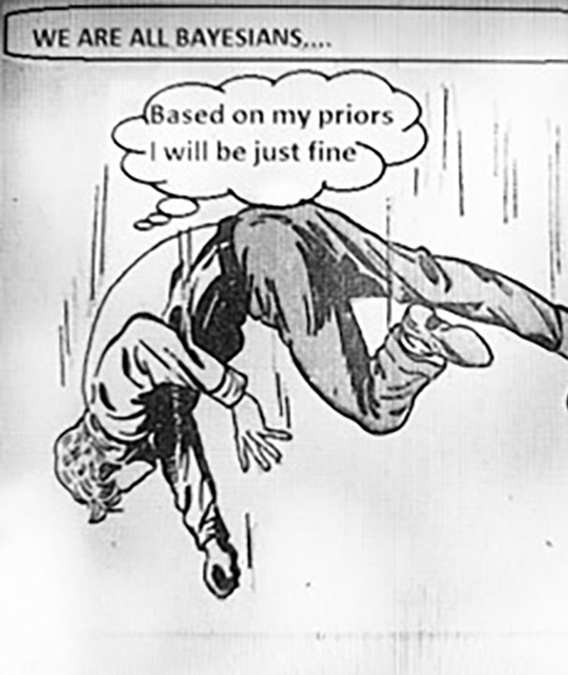
Bayesians can be insufferably smug. We love it when they screw up! Generally- Bayesian methods require more expertise to implement correctly and robustly.

Slide 32
My pragmatic view… pick horses for courses
REML + Fast + Limited potential to generate nonsense - Not great for non-Gaussian errors - Hard to carry uncertainty forward to further calculations/analyses/models LME4, NLME, ASRemlR, WOMBAT, Genstat
MCMC
- Slow (comparatively, and for MV models)
- Infinite potential to generate nonsense
(e.g. need to understand priors!)
+ Better if you really need GLMM
+ Posteriors let you carry uncertainty forward to further calculations/analyses
MCMCglmm, JAGS, BUGS, STAN

Slide 33
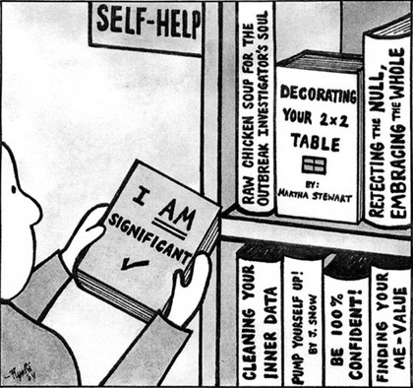
3. How do I test “significance” of effects?
FAQ’s

Slide 34
REML - Significance of random effects
REML estimates SE's on estimated variance components
Z score (ratio of Comp/SE) sometimes reported (e.g. ASReml)
Roughly speaking, 95% CI are +/- 2 SE’s but best not used for formal testing.
Source Model terms Gamma Component Comp/SE % C
BYEAR 20 20 0.617382E-01 0.584116E-02 2.53 0 P
ANIMAL 5720 5720 0.617232 0.583974E-01 9.47 0 P
Variance 2978 2965 1.00000 0.946118E-01 18.28 0 P
> 2 (or less than -2 for negative covariances)

Slide 35
REML - Likelihood ratio test (LRT) of random effects
Compare likelihood of two models 1 (with k₁ variance components) and 2 (with k₂ variance components) where logL₂>LogL₁
Test statistic = 2log(L₂ /L₁) = 2[log(L₂) – log(L₁)]
2[log(L₂) – log(L₁)] ~ Χ²_{k2-k1}
Adding 1 random effect adds one variance component so k₂-k₁ =1
For α of 0.05, critical value of the test statistic based on Χ²_{1DF} is 3.8
Add a random effect, does the logL increase by >1.9 ?

Slide 36
Model 1 y ~ mu + ANIMAL LogL= -253.6
Model 2 y ~mu + ANIMAL + MOTHER LogL= -250.9
Test statistic = 2x(-250.9 - -253.6) = 5.4
MOTHER adds one parameter to estimated so k2 - k1 =1
For Χ²_{1DF} a value of 5.4 gives P = 0.020*
Some argue this is too conservative as variances are normally bound to positive parameter space - see Stram and Lee 1994 Biometrics.

Slide 37
If REML (as opposed to ML) used, the LRT is only valid for comparing models with different (nested) random effects but identical fixed effect structures
AIC can be used for model selection when random effects are not nested. Same caveat about fixed effects as AIC calculated from LogL
Likelihood based model comparisons not generally valid for frequentist GLMM methods (e.g. penalised quasi-likelihood ,PQL)

Slide 38
REML - Significance of fixed effects
Not everyone agrees on the best approach, method implemented depend on what statistical software you are using.
t or z statistics - hmmm a useful guide, but true DF murky given random effects.
F statistics with numerator and denominator DF – the latter is approximated using one of several available methods (ASReml does this)
LRT – Have to refit full and reduced models using ML instead of REML (LME4 does this)
Some form of bootstrapping to get CI. Do 95% CI contain an effect size of zero?

Slide 39

Bayesian MCMC methods
Smug Bayesian
‘P values are silly, null model hypothesis testing is stupid. Just focus on my effect sizes. Honestly just look at my posterior… its so awesome’
Reviewer
What a tool, reject.

Slide 40
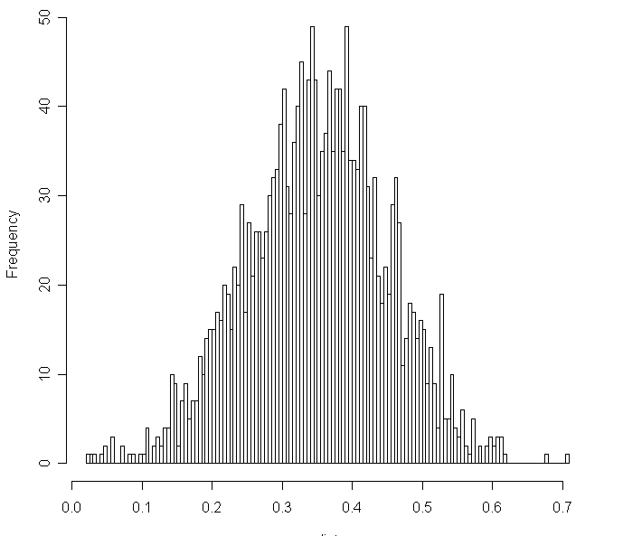
Bayesian MCMC methods
Recognise your readers are probably trained in the frequentist tradition, even if you wish they weren’t. Try to meet them (at least) half way.
Look at 95% credible interval for posterior distribution of parameter of interest, does it include zero
But this is usually constrained to be >0 for variances
DIC maybe?
Bayes factors?
Arm waving statements?
Estimate as posterior mode

Slide 41
FAQ’s
How do I choose a model?
“all models are wrong, but some are useful”
G.E.P. Box

Slide 42
My best model depends on
Most important ?
Biological question
Likely sources of bias
Available data
Modeling philosophy (explaining variance vs hypothesis testing)
Statistical significance
You need to make your decisions.
Some people will disagree with some them. Deal.

Slide 43

Need a break?
Then we will quickly talk about random slope models before getting stuck in….

Slide 44
Recap
Till now we have been talking about a type of simple mixed model sometimes referred to as a ‘random intercept model’
We can add more than one random effect if we want, e.g. ID, year, mum.
For each random effect factor (e.g. ID), we will estimate a variance
We model a deviation from the fixed effect mean for each factor level
Deviations are constant across repeats on the same level of any factor
Across all levels of the random factor, the deviations have a mean of zero, and a variance we are trying to estimate

Slide 45
Our random intercept model
y_{i} = b x + c + ID_{i} + ε_{i}
y
Fixed effect mean
Mean y changes with x
Deviation from mean y caused by ID effect is constant
Individual deviation captured by a single ‘random intercept’
x

Slide 46
Our random intercept model
y_{i} = b x + c + ID_{i} + ε_{i}
y
Why does this matter?…
For any single individual i, ID_{i(x=0)} = ID_{i(x=1)}= ID_{i(x=132)} etc
For set of individuals observed at any values x1 and x2
Var(ID_{(x1)}) = Var(ID_{(x2)})
r(ID_{(x1},ID_{(x2}) = +1
x1
x2
x
…you’ll see later

Slide 47
A random slope model (aka random regression)
y
Fixed effect mean
Individuals differ in intercept and slope
Individual’s deviation from the fixed effect mean is no longer constant with x
It is no longer necessarily true that Var(ID_{(x1)}) = Var(ID_{(x2)})
x1
x2
x

Slide 48
A random slope model (aka random regression)
y
Fixed effect mean
Individuals differ in intercept and slope
Individual’s deviation from the fixed effect mean is no longer constant with x
It is no longer necessarily true that Var(ID_{(x1)}) = Var(ID_{(x2)})
It is no longer necessarily true that r(ID_{(x1},ID_{(x2}) = +1
x1
x2
x

Slide 49
Why do we want to use these?
Can sometimes think of slopes as latent ‘traits’
Y | X | Slope
Size | Age | Growth
Cognitive trait | Experience | Learning
Any trait | Any Environment | Plasticity
y
Fixed effect mean
y_{ix} = b x + c + ID_{int(i)} + x·ID_{slp(i)} + ε_{ix}
x1
x2
x
Two random effects associated with identity a random intercept, and a random slope
Individual deviation from fixed effect mean is not constant, but a first order (linear) regression of x

Slide 50
Why do we want to use these?
Can sometimes think of slopes as latent ‘traits’
Y | X | Slope
Size | Age | Growth
Cognitive trait | Experience | Learning
Any trait | Any Environment | Plasticity
y
Fixed effect mean
Do individuals vary in rate of learning ?
x1
x2
x
V_{ID(int)} COV_{ID(int.slp)}
COV_{ID(int.slp)} V_{ID(slp)}
But be careful… there are 3 random effect (co)variances now

Slide 51

Let’s try some models

